Slide 1
Event-ir
Presented
Emergency Ventilator for COVID-19 Pandemic

Slide 2
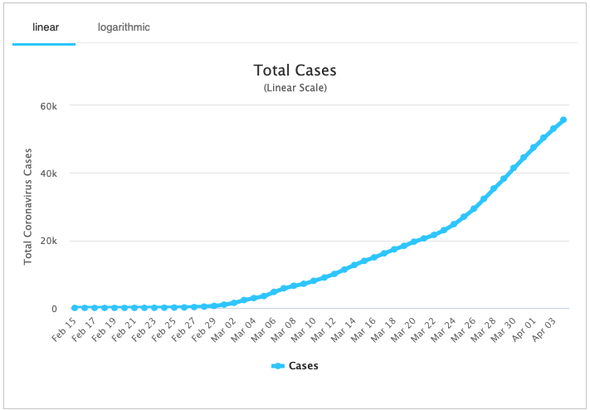
Project Goal
The COVID-19 pandemic may cause ventilator shortages in Iran and other countries
An increase in conventional ventilator production is very likely to fall short (2 to 4 times of available number)
Being a global pandemic, and severe imposed sanctions on Iran, make importing conventional ventilator a less feasible solution.
The project goal is automating a manual resuscitator, as a possible means for longer-term ventilation.
Number of confirmed cases in Iran From Feb 15 to Apr 03
Notes:
I think that we cannot OVERCOME the COVID-19 pandemic, but we want to offer a short-term solution… That’s why I propose this slide… instead of what you had prepared… Anyway… You’re the BOSS, we’ll listen to you Amir
Amir:=)))) Ekhtiar darin , I am a simple worker of yours. <3 your slide is much better than what i did. Thank you

Slide 3
Available Designs & Discussions
Flexible
Simplicity
Short Design to Production Time
Low Cost
Easy to Use
Functional
Efficient

Slide 4
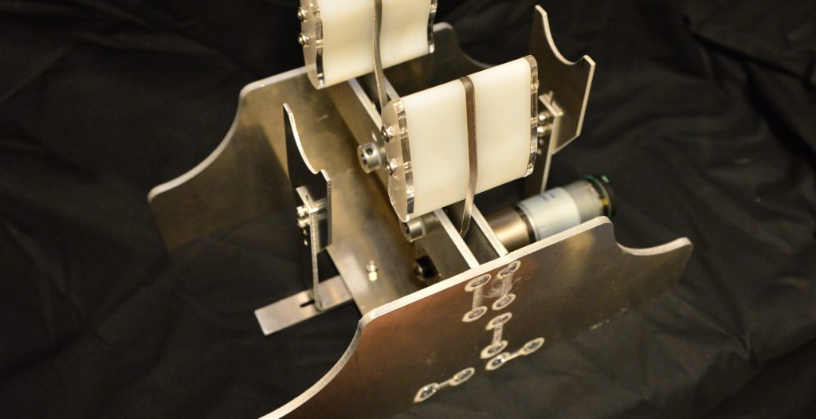

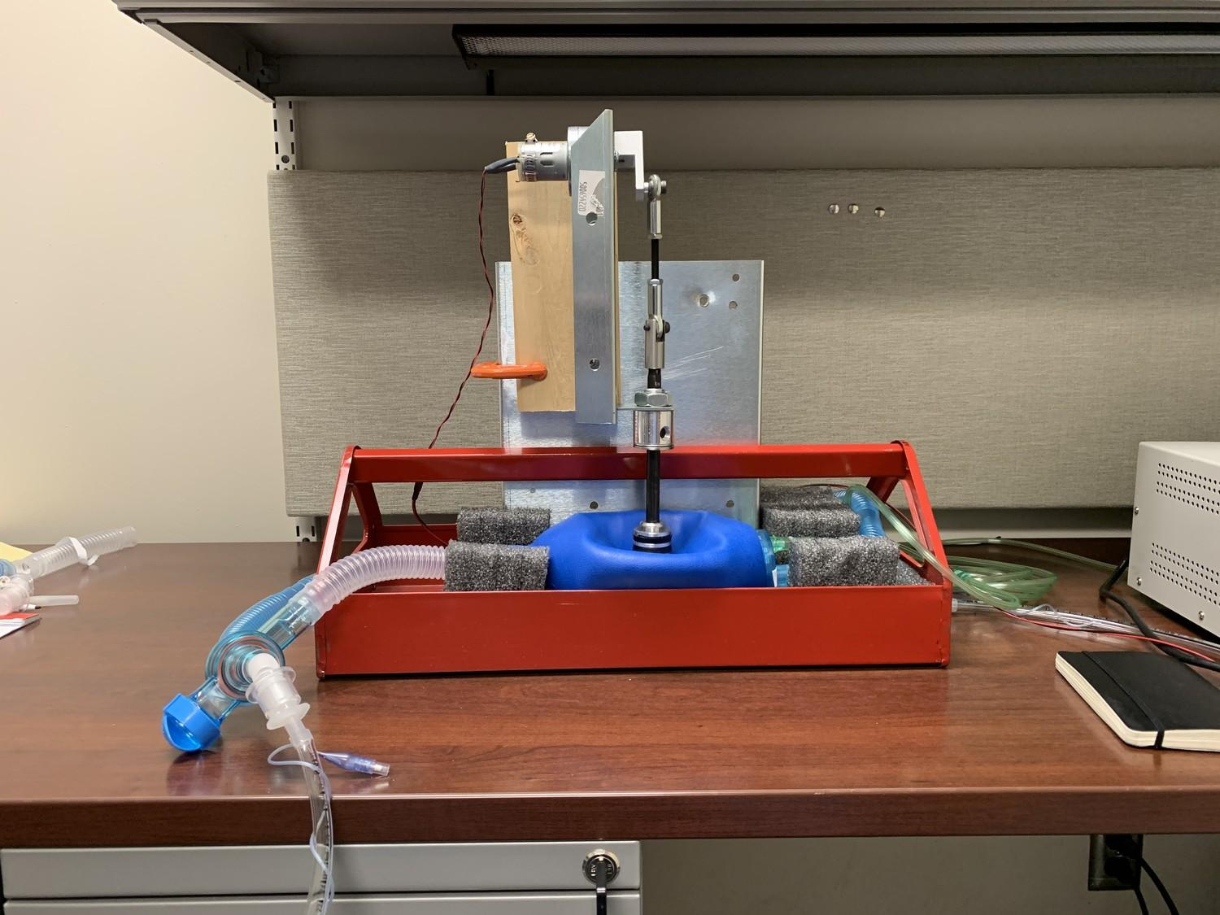
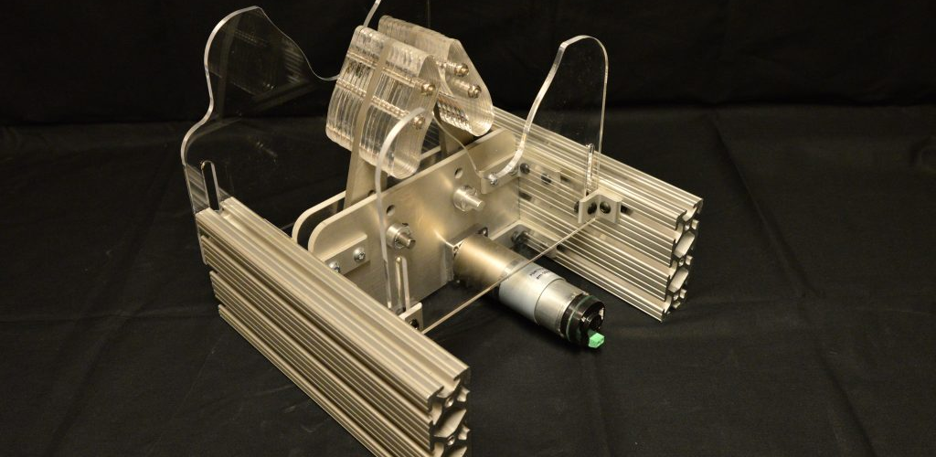
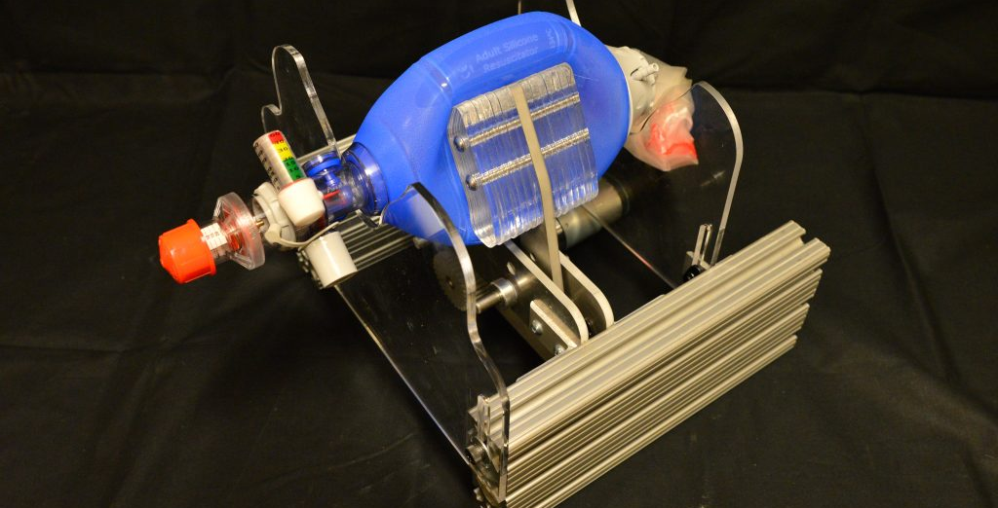
MIT E-Vent
MINNESOTA
This E-Vent is being tested in animal models, and the E-Vent is being improved in a daily manner. The information regarding the test results and design specification is available.
They aim to build a low-cost, scalable mechanical ventilator that will augment existing medical equipment to increase availability of mechanical ventilation. Unfortunately, the information regarding the test are not available.

Slide 5
Design Specification
Patients must be under the management of a trained clinician.
The minimum controllable parameters in order to ventilate a patient include:
Respiratory Rate (RR) (breaths per minute): between 8 – 40
Tidal Volume (TV) (air volume pushed into lung): between 200 – 800 mL based on patient weight
I/E Ratio (inspiratory/expiration time ratio): recommended to start around 1:2; best if adjustable between range of 1:1 – 1:4
Assist Detection pressure. When a patient tries to inspire, they can cause a dip on the order of 1 – 5 cm H2O, with respect to PEEP pressure (not necessarily = atmospheric).
Airway pressure must be monitored
Failure conditions must permit conversion to manual clinician override
Source: https://e-vent.mit.edu/
Notes:
I think that we cannot OVERCOME the COVID-19 pandemic, but we want to offer a short-term solution… That’s why I propose this slide… instead of what you had prepared… Anyway… You’re the BOSS, we’ll listen to you Amir

Slide 6
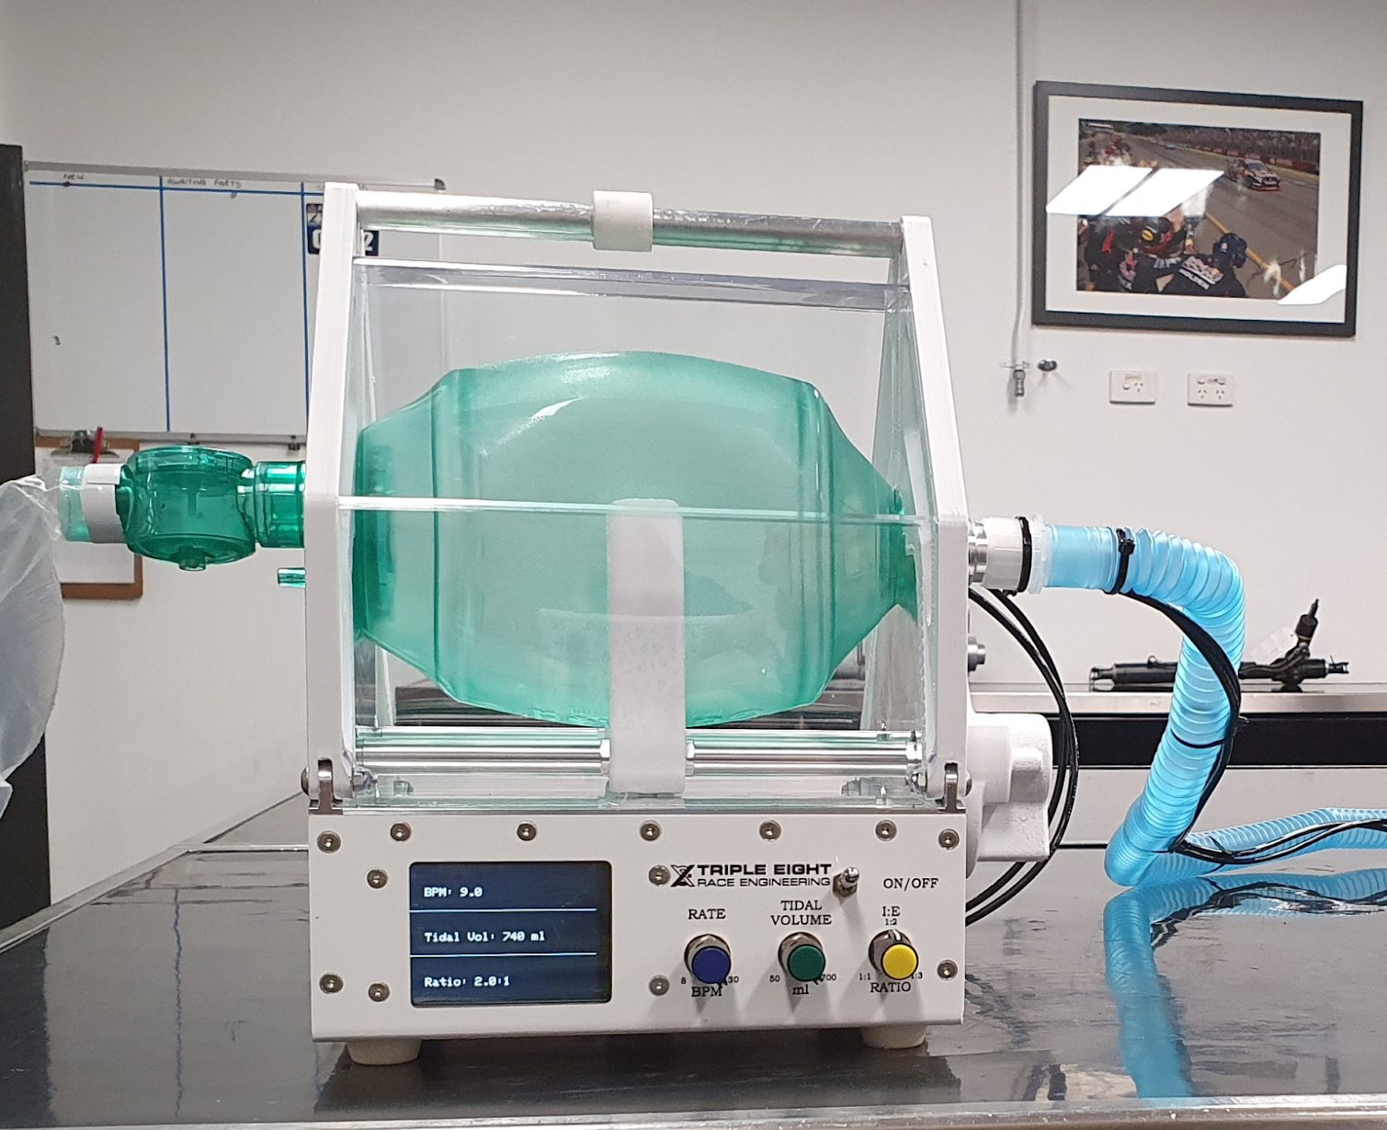
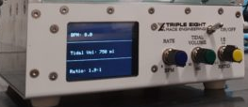
EVent-ir Design
Two main parts:
Ventilation Mechanism
Control Panel
Final product would be like this:

Slide 7
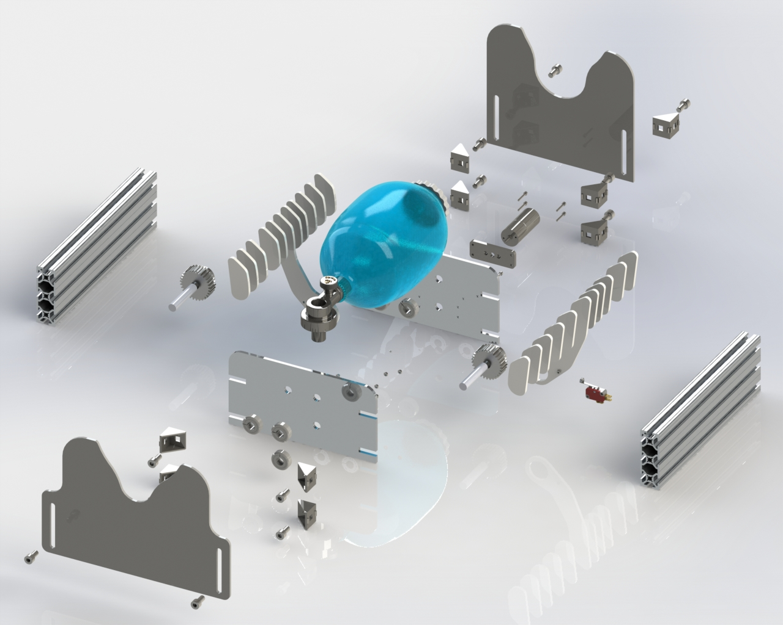
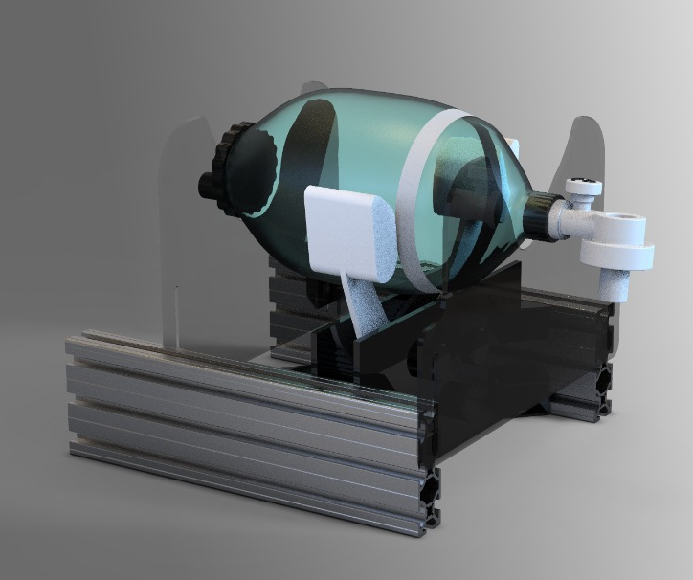
Our Mechanical Design
Based on available parts and material
Easy to build
Low price and reliable

Slide 8

Our Mechanical Deisgn

Slide 9
Expected Costs (Estimated)
Mechanics | Parts | 500000
 | Manufacture | 400000
Electronics | Parts | 900000
 | Manufacture | 200000
Sum |  | 2000000
* For larger quantities, prices will be reduced.

Slide 10




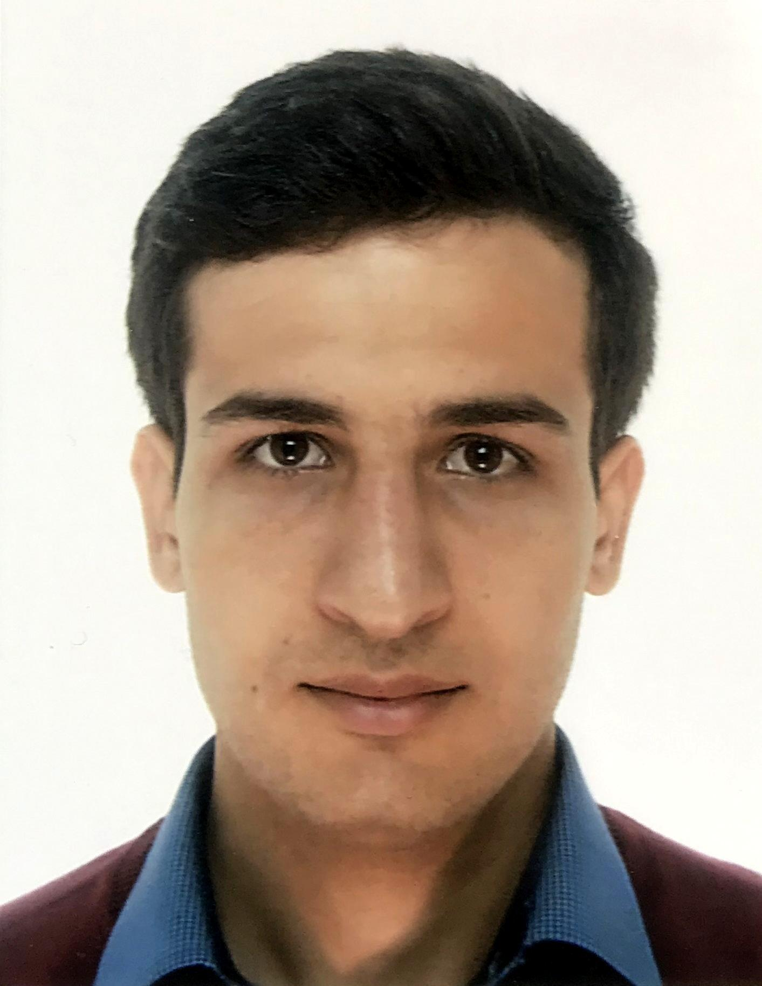
Team
Amir Soutehkeshan
Master of Science at the University of Tehran in the field of Integrated Circuits
System Engineer at SEDNA (sednaco.ir)
Asal Golmanesh
Master of Science at the University of Tehran in the field of Integrated Circuits
Electronic Engineer at Araz-Faraz-Jahan
Mohammad Hossein Ghasemi
Master of Science at the University of Tehran in the field of Electrical Engineering
Embedded System Developer at Araz-Faraz-Jahan
Arash Moghadas
Bachelor of Science at the University of Art in the field of Industrial Design
Industrial engineer at Sedna electronic group
Saman Vafadar
Master of Science at the University of Tehran in the field of Applied Mechanics
PhD student at Arts et Metiers ParisTech
Short Design to Production Time
Easy to Use

Slide 11
Current State
Mechanical Design:
First concept is modeled in Solidworks
We are building the first prototype
Electronics:
Motor drive is done and tested
Interface panel is progressing

